Slide 1
DATA ANALYTICS AIRLINE DATA ANALYTICS FOR AVIATION INDUSTRY

Slide 2
TEAM MEMBERS:
SINEKA.V
VINOTHINI.P
SRUTHI.R
THARANI.E

Slide 3
PROJECT DEVELOPMENT PHASE
SPRINT 1
COLLECTING THE DATA
UPOADING THE DATA
PREPARING THE DATA
SPRINT 2
EXPLORATION OF DATA
PRESENTATION OF DATA
SPRINT 3
CREATING INTERATIVE DASHBOARD WITH EXCLUSIVE GRAPHICAL REPRESENTATION
SPRINT 4
REPORT CREATION AND STORY CREATION

Slide 4
SPRINT 2

Slide 5
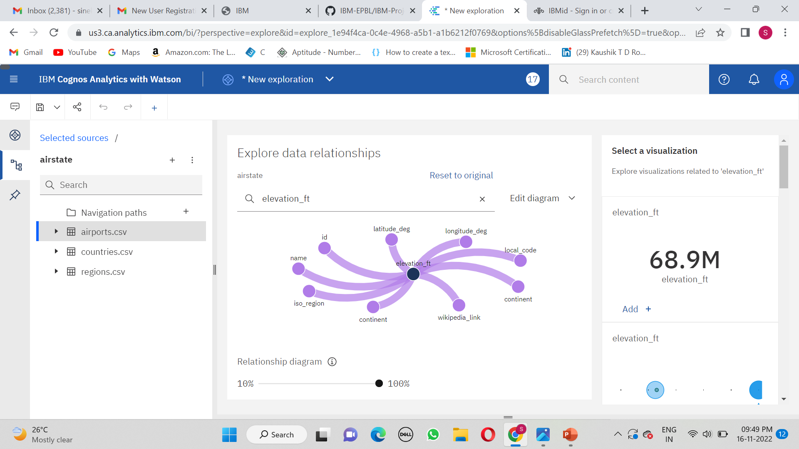
1.EXPLORATION OF DATA

Slide 6
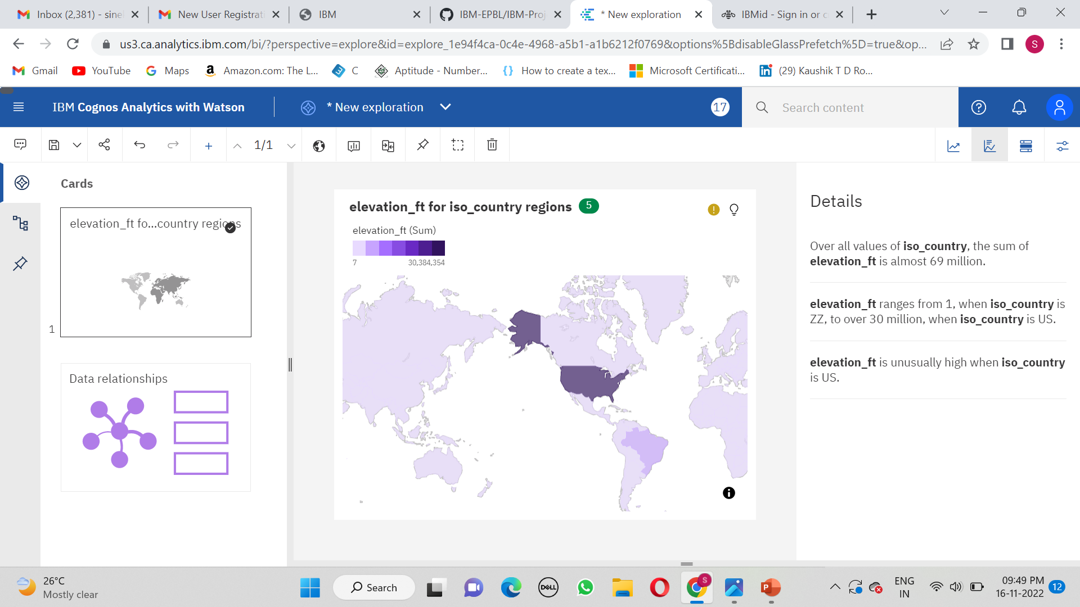

Slide 7
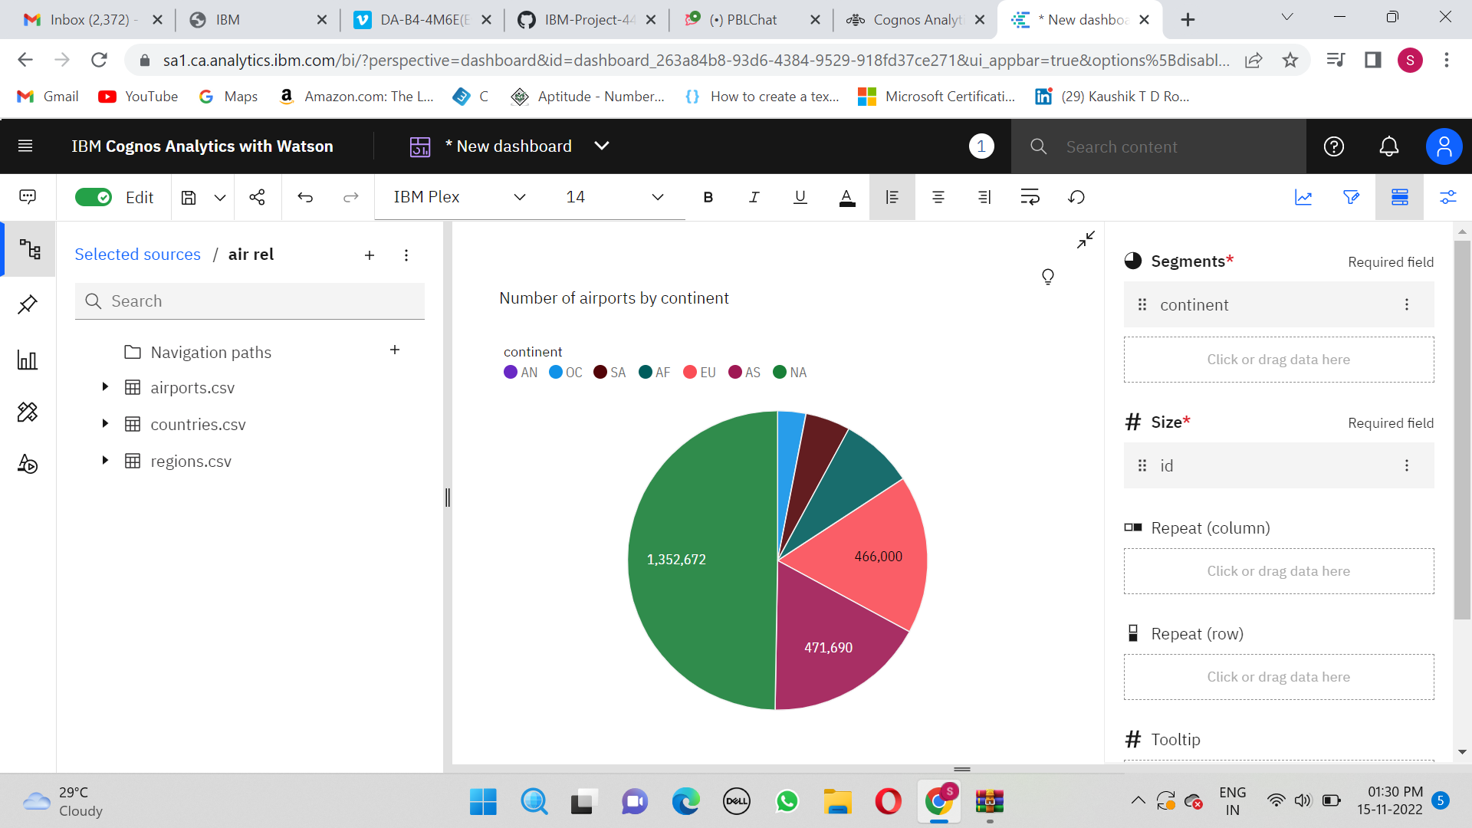
2.PRESENTATION OF DATA USING VISUALIZATION

Slide 8
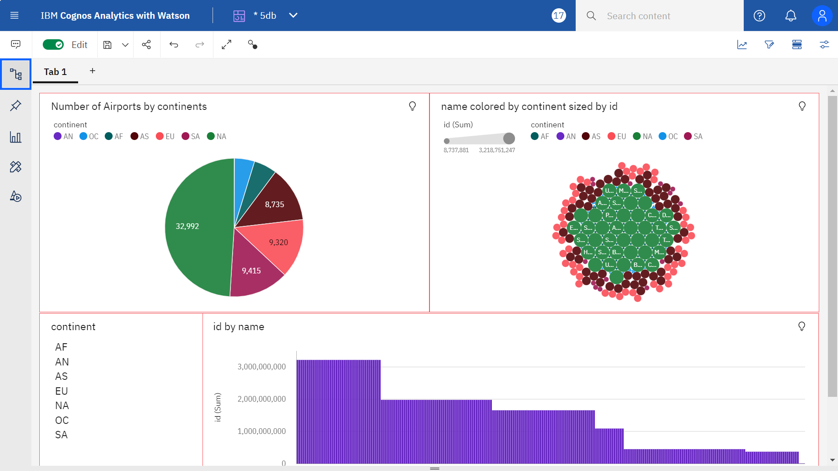

Slide 9
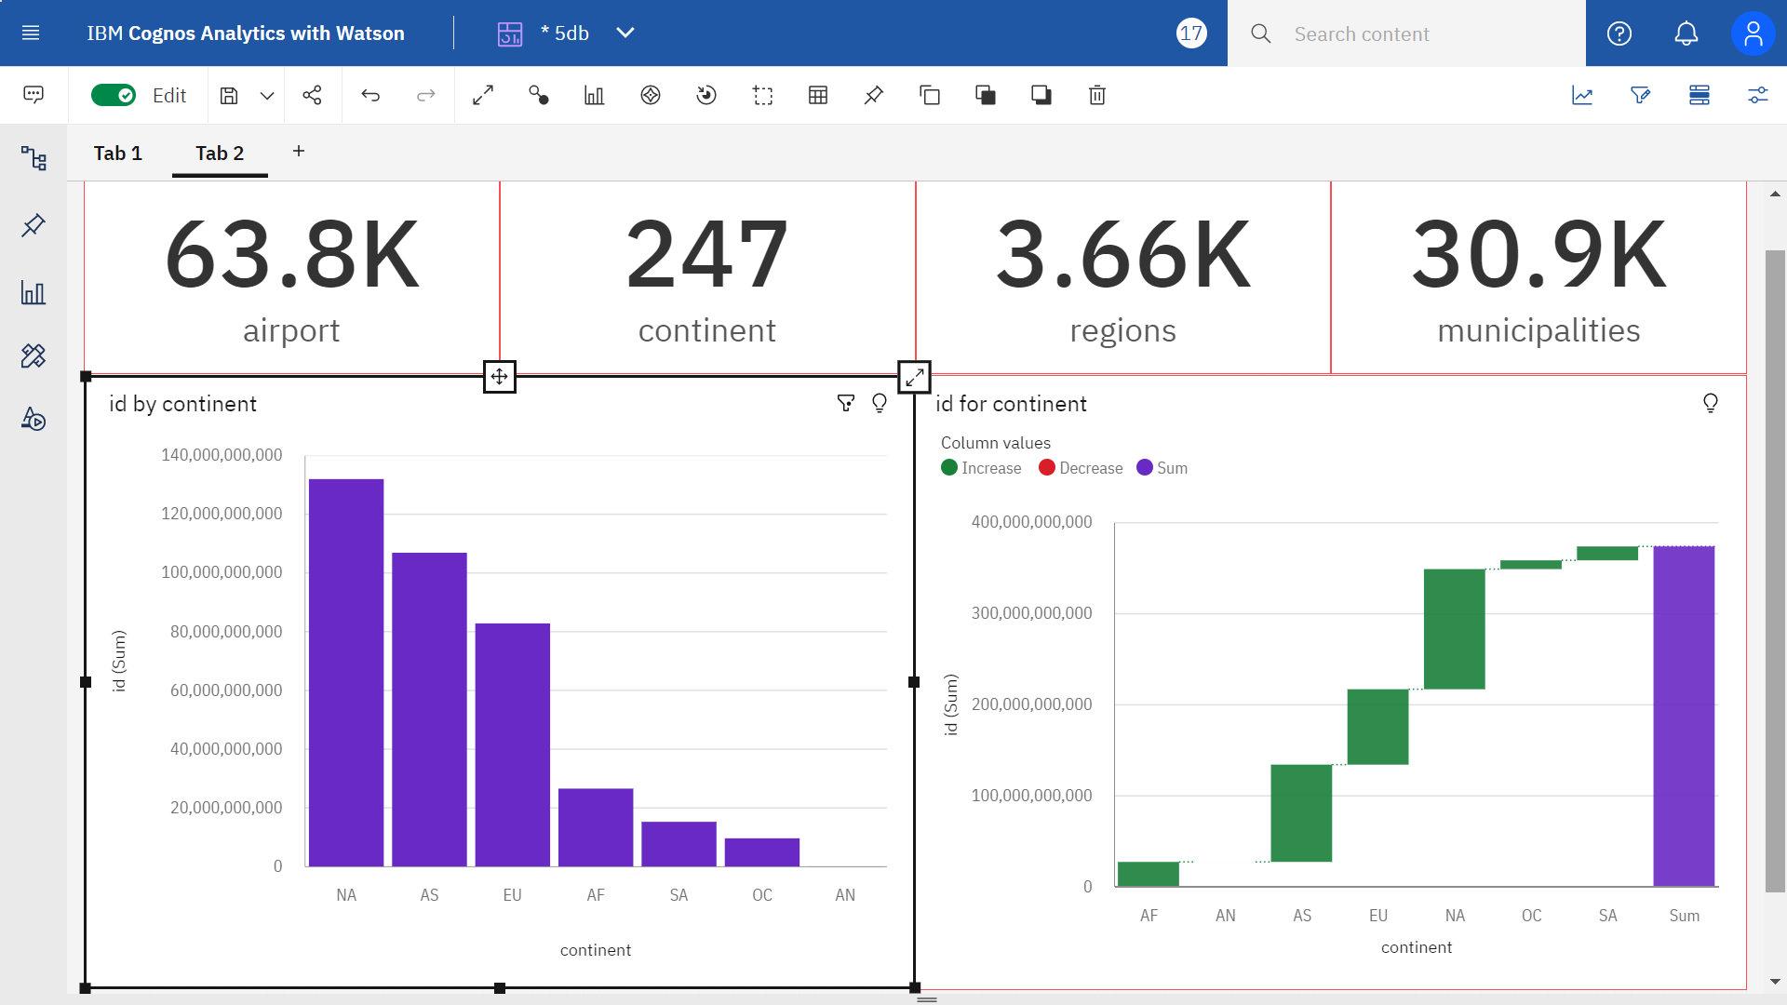

Slide 10
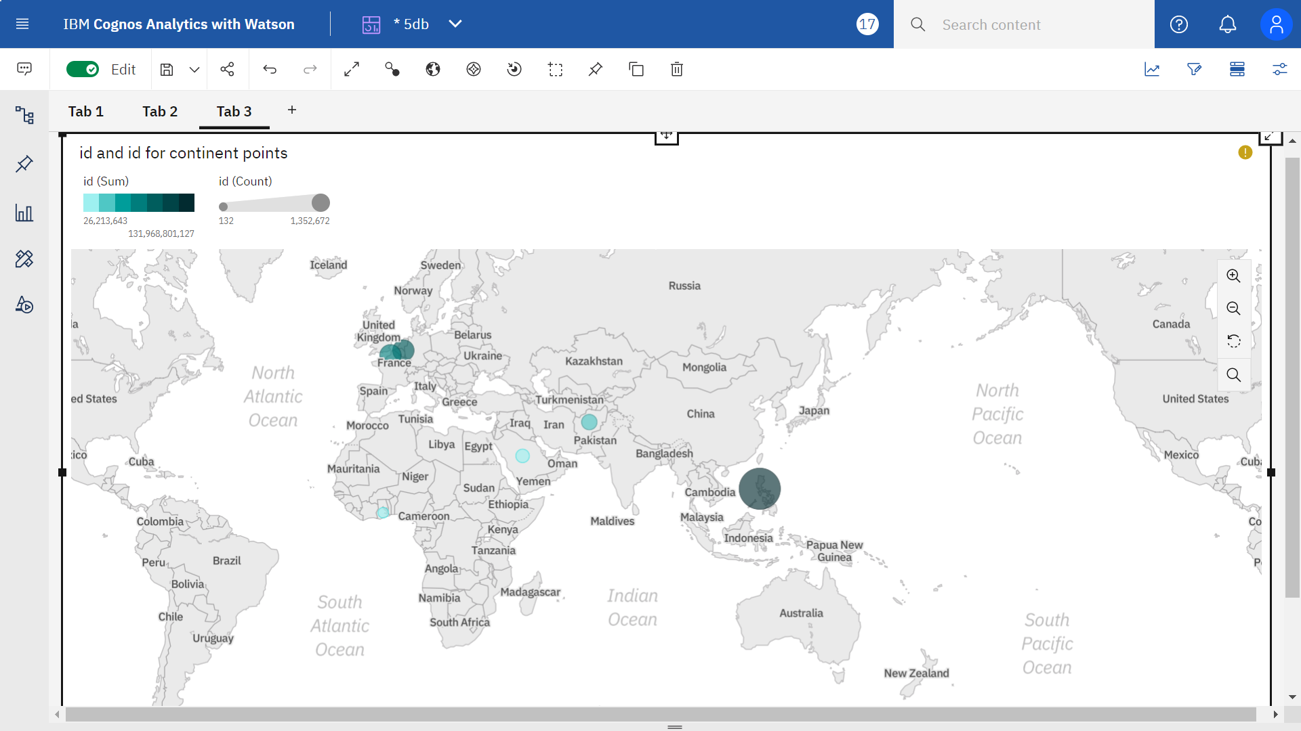

Slide 11
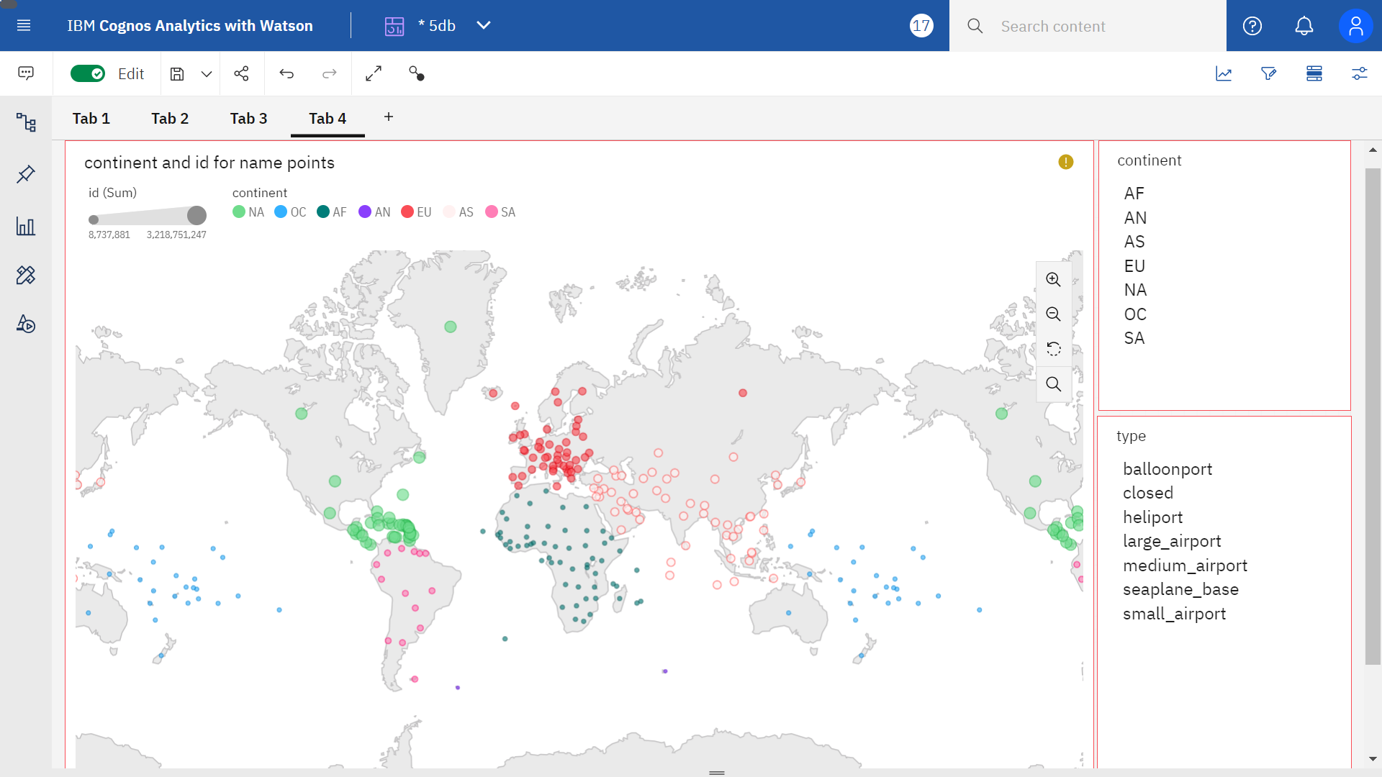

Slide 12
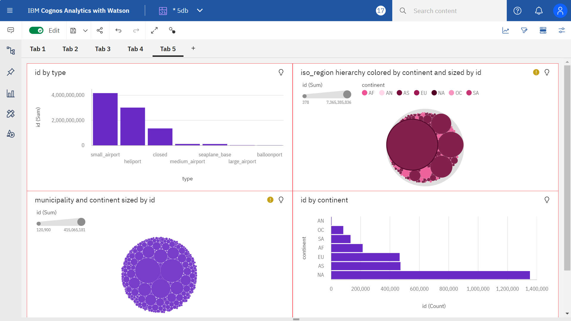

Slide 13
THANK YOU

